Slide 1
Windows Image Creation
Fort Wayne VMug 2019

Slide 2

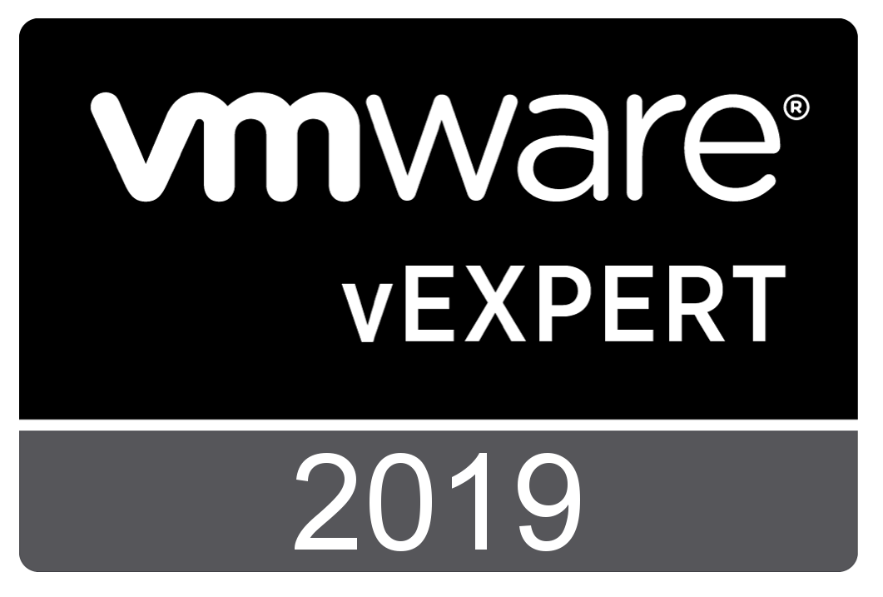
About Me
Network Engineer @ Huntington County Community School Corporation
Worked in IT for 15 + years
2018, 2019 VMWare vEXPERT
For fun I referee Soccer
Love Purdue Men's Basketball
Twitter @jryanwall

Slide 3



Stand on the shoulders of others
Jeff Downs
@edtech_jeff
Johan Arwidmark
@jarwidmark
Mikael Nystrom
@mikael_nystrom

Slide 4
My Build Lab
Consists of 4 VM’s running in Hyper-V running on desktop
DC01
2 Virtual Processors
2 GB Ram
60 GB Hard Drive
MDT01
2 Virtual Processors
8 GB Ram
300 GB Hard Drive
WSUS01
2 Virtual Processors
8 GB Ram
400 GB Hard Drive
RefPC-001
2 Virtual Processors
4 GB Ram
128 GB Hard Drive

Slide 5
My Build Lab continued
My production build machine is HP ZBook Studio x360 G5, 36 GB Ram, 4 TB NVME HD, running Windows 10 1709.
This lab was built with Johan Arwidmark’s hydration kit available from his web site.
I changed the IP range to not interfere with my home router.

Slide 6
Agenda – Section 1
The Setup
Installing MDT 8450
Installing ADK 1809
Installing ADK WinPE 1809
Creating Build Share in MDT
Configure and Customizing Build Share
Bootstrap.ini
CustomSettings.ini
It all starts with the Media
Updating media
OSDBuilder
Demo

Slide 7
Agenda – Section 2
Customize
Add Applications
Office 2016
Script to Update Office 2016
OSDUpdate (PowerShell Modal)
Update-Office (PowerShell Script)
Office 365 Pro Plus
Visual C++ run times
Other Apps
Import OS to MDT
Customizing/Tweaking OS
Background Changes
Lock Screen Changes
Start Menu Layout
Remove Built-in Apps
Task Sequence
Create Task Sequence
Adjust Power plan
Disable/Enable Windows Store Update Scripts
Enable RDP
Clear WSUS Script
Cleanup Image Script
Demo
Helpful Info

Slide 8
Agenda – Section 3
Build, Capture, Automation
Build and Capture
Image Factory
Demo
Questions
Break

Slide 9
Agenda – Section 4
Setup
Create Deployment Share
Customize Deployment Share
Import Custom WIM
WDS and PXE setup
Create Task Sequence
Demo
Questions

Slide 10
Agenda – Section 5
Drivers and BIOS
Modern Driver Implementation
Model Alias
Driver Automation Tool
BIOS upgrade during deployment
Task Sequence adjustments for drivers and BIOS update
Demo
Questions

Slide 11
Agenda – Section 6
Bringing it all home
Old Computer Name
Final Task Sequence Adjustment
Local Admin changes
Local accounts
Activate Office
OEM Customization
Generate Windows Experience
Bringing it all home…
Logging
Website status page
Demo
Questions

Slide 12
Section 1
Getting things started on the right foot.

Slide 13
Agenda – Section 1
The Setup
Installing MDT 8450
Installing ADK 1809
Installing ADK WinPE 1809
Creating Build Share in MDT
Configure and Customizing Build Share
Bootstrap.ini
CustomSettings.ini
It all starts with the Media
Updating media
OSDBuilder
Demo

Slide 14
Things you will need
Computer to build images on (Laptop or Server)
Windows 10 Enterprise iso (1809, 1803, or 1709)
OSDBuild PowerShell Module
Windows 10 ADK 10 v 1809
WinPE addon for Windows 10 ADK v1809
Microsoft Deployment Toolkit (MDT) 8450
Script to relax deployment share permissions

Slide 15
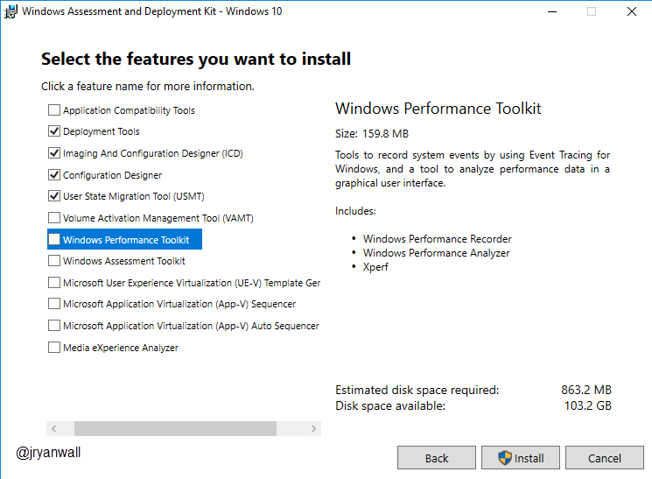
Windows ADK Install
You don’t need all options.
Only need
Deployment Tools
Imaging and Configuration Designer (ICD)
Configuration Designer
User State Migration Tool

Slide 16
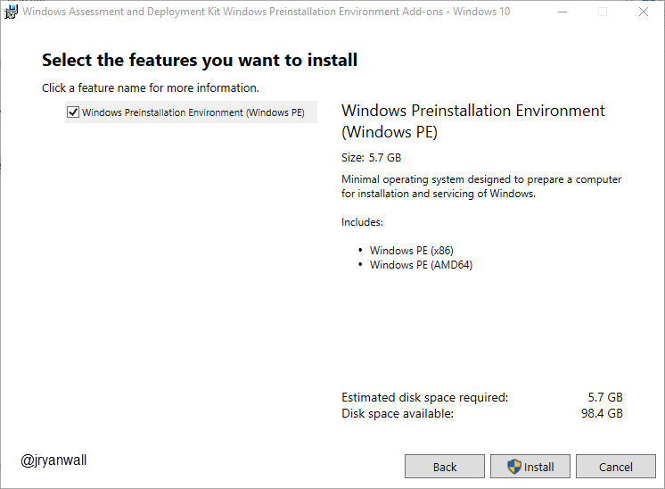
Windows ADK WinPE
No Options on this one
Just Next, Next, Next, Install

Slide 17
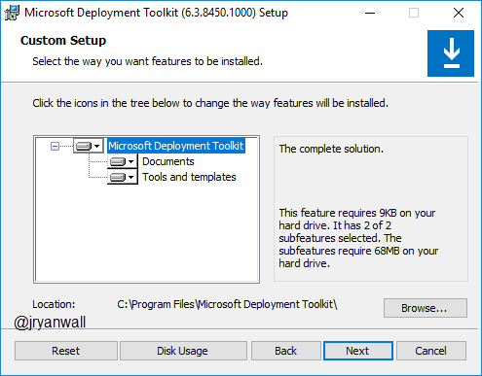
MDT 8450
Take everything

Slide 18
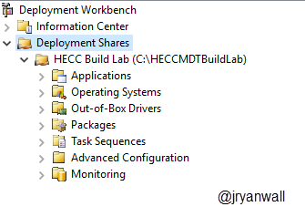
Create Deployment Share
Open Deployment Workbench
Right Click on Deployment Share and select New Deployment Share
For Lab Continuity use these settings…
Deployment share path C:\HECCMDTBuildLab
Share name HECCMDTBuildLab$
Except all other prompts

Slide 19
Create Deployment Share … Easy way
Run PowerShell script to do all above
New-Item -Path "E:\VMUGMDTBuildLab" -ItemType directory
New-SmbShare -Name “VMugMDTBuildLab$" -Path "E:\VMUGMDTBuildLab" -FullAccess Administrators
Import-Module "C:\Program Files\Microsoft Deployment Toolkit\bin\MicrosoftDeploymentToolkit.psd1"
new-PSDrive -Name "DS008" -PSProvider "MDTProvider" -Root “E:\VMugMDTBuildLab" -Description “VMug Build Lab" -NetworkPath "\\MDT01\VMugMDTBuildLab$" -Verbose | add-MDTPersistentDrive -Verbose
Notes:
New-Item -Path "C:\HECCMDTBuildLab" -ItemType directory
New-SmbShare -Name "HECCMDTBuildLab$" -Path "C:\HECCMDTBuildLab" -FullAccess Administrators
Import-Module "C:\Program Files\Microsoft Deployment Toolkit\bin\MicrosoftDeploymentToolkit.psd1"
new-PSDrive -Name "DS001" -PSProvider "MDTProvider" -Root "C:\HECCMDTBuildLab" -Description "HECC Build Lab" -NetworkPath "\\AS-TEC-PROBK-01\HECCMDTBuildLab$" -Verbose | add-MDTPersistentDrive -Verbose

Slide 20
Configuring Deployment Share
What is the point of the configurations
Simplify image creation process
Ultimately make image creation process scriptable or lite touch
Cleanup unneeded screens

Slide 21
Main files to configure
Bootstrap.ini
File is processed first
Only processed once
Located in %DeploymentShare%\Control\
CustomSettings.ini
Processed after Bootstrap.ini
Is the rules file processed by ZTIGather.wsf
Located in %DeploymentShare%\Control\
Notes:
Bootstap.ini
https://itinlegal.wordpress.com/2017/10/17/mdt-tutorial-part-5/
CustomSettings.ini
https://itinlegal.wordpress.com/2017/10/15/mdt-tutorial-part-4/
https://deploymentbunny.com/2012/04/21/back-to-basic-customsettings-ini-explained/
https://deploymentbunny.com/2015/05/22/back-to-basic-customsettings-ini-converting-desktop-and-laptop-computer-types-into-roles/

Slide 22
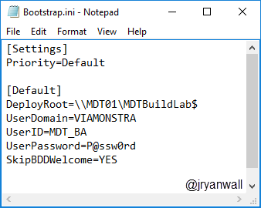
Bootstrap.ini
For golden image we need the following changes made

Slide 23
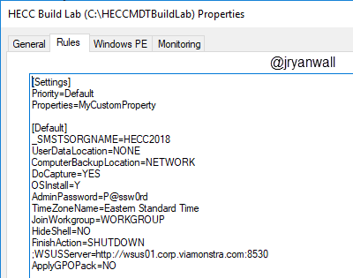
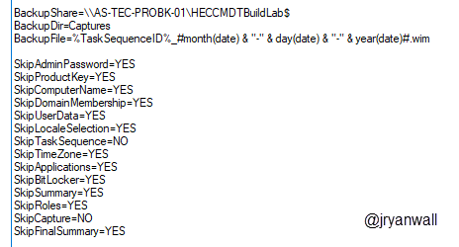
CustomSettings.ini
These are the settings I use. You may not need all of them and you may need to adjust some to your environment.

Slide 24
OSDBuilder – Offline Servicing
Why Offline Servicing is useful
Speed up Build Capture
Updated media for fresh install
You can update Windows 10 and Windows Server 2016/2019

Slide 25
OSDBuilder – Offline Servicing
https://www.osdeploy.com/osdbuilder/home
https://www.moderndeployment.com/quick-start-guide-windows-10-waas-servicing-updates-via-osdbuilder/

Slide 26
Demo

Slide 27
Section 2
Getting things started on the right foot.

Slide 28
Agenda – Section 2
Customize
Add Applications
Office 2016
Script to Update Office 2016
OSDUpdate (PowerShell Modal)
Update-Office (PowerShell Script)
Office 365 Pro Plus
Visual C++ run times
Other Apps
Import OS to MDT
Customizing/Tweaking OS
Background Changes
Lock Screen Changes
Start Menu Layout
Remove Built-in Apps
Task Sequence
Create Task Sequence
Adjust Power plan
Disable/Enable Windows Store Update Scripts
Enable RDP
Clear WSUS Script
Cleanup Image Script
Demo
Helpful Info

Slide 29
Things you will need
Software you want to install
Understanding of what you want to customize
Good lab setup to test
Time to test and tweak

Slide 30
Add Applications Office 2016
Need Office 2016 install media
Create MSP file by running setup.exe /admin
Add installer to MDT
Notes:
Walk through
https://web.sas.upenn.edu/jasonrw/2015/11/03/automate-the-install-of-microsoft-office-2016-with-an-msp-file/
PowerShell
Import-Module "C:\Program Files\Microsoft Deployment Toolkit\bin\MicrosoftDeploymentToolkit.psd1"
New-PSDrive -Name "DS001" -PSProvider MDTProvider -Root "C:\HECCMDTBuildLab"
import-MDTApplication -path "DS001:\Applications" -enable "True" -Name "Install - Microsoft Office 2016 x86" -ShortName "Install - Microsoft Office 2016 x86" -Version "" -Publisher "" -Language "" -CommandLine "setup.exe" -WorkingDirectory ".\Applications\Install - Microsoft Office 2016 x86" -ApplicationSourcePath "C:\_Setup\_AppInstallFiles\Microsoft Office 2016" -DestinationFolder "Install - Microsoft Office 2016 x86" -Verbose

Slide 31
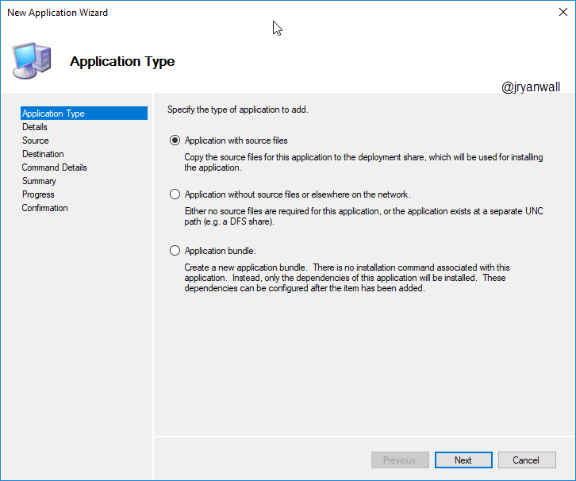
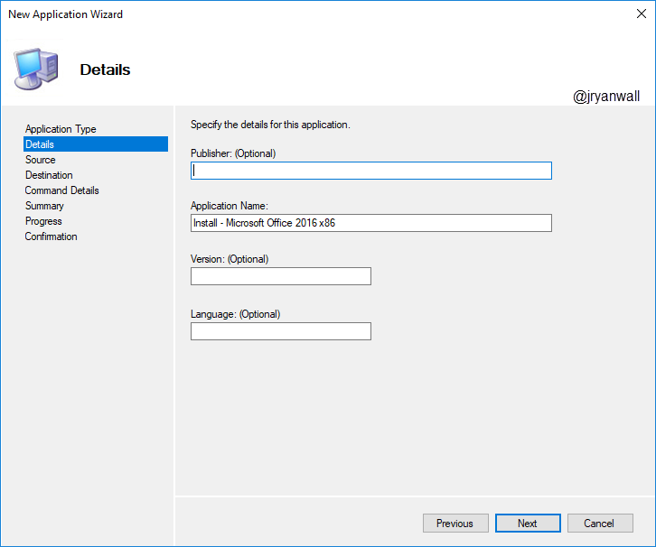
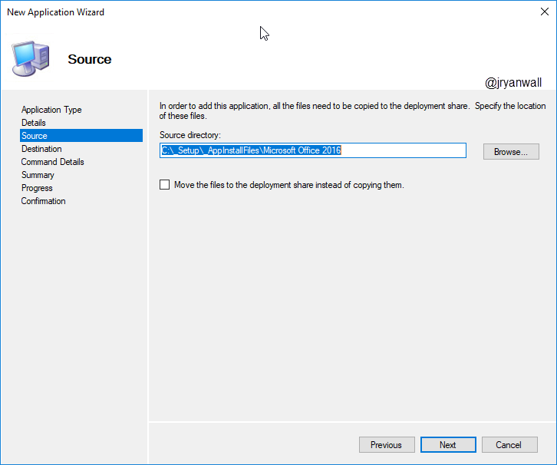
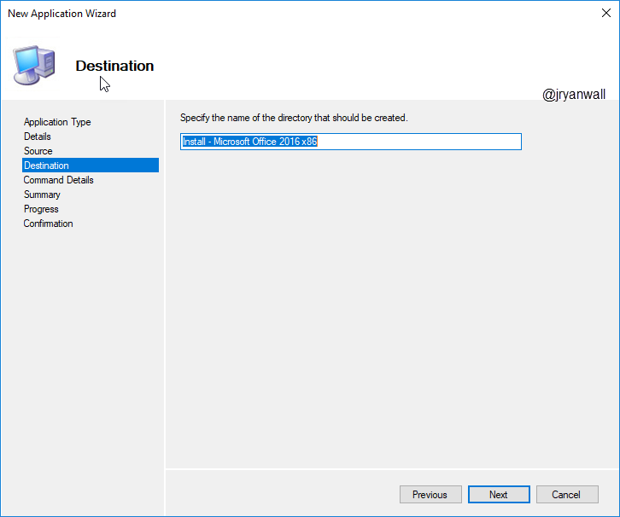
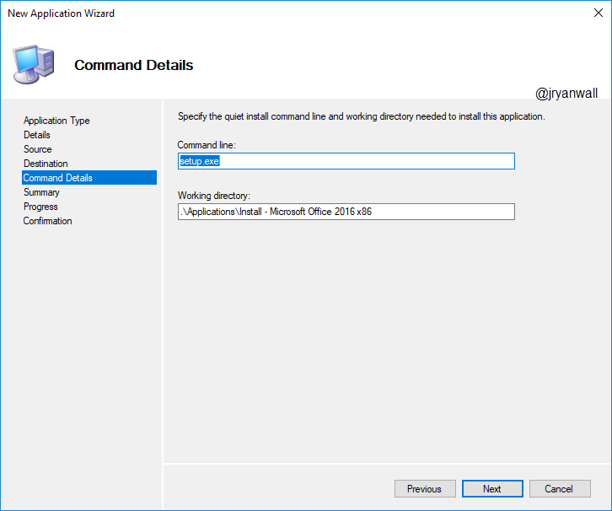
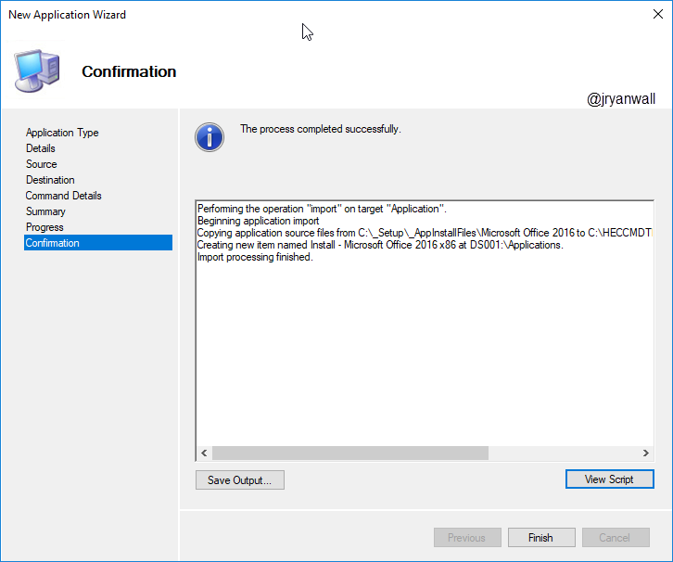
Add Applications Office 2016

Slide 32
Update Office Application
Faster than adding .msp file to setup/update directory
Get Office 2016 Update using OSDUpdate
https://www.osdeploy.com/osdupdate/releases
PowerShell Script to install Office 2016 Updates
https://github.com/SuneThomsenDK/Update-Office

Slide 33
Add Applications Office 365 Pro Plus
A work in progress
Informational links
https://sysadminedu.wordpress.com/2017/01/07/step-by-step-guide-to-deploying-office-365-pro-plus-with-device-based-activation-with-sccm/
http://www.scconfigmgr.com/2018/05/29/include-office-365-proplus-in-your-windows-10-reference-image/

Slide 34
Add Applications Visual C++ runtimes
C++ runtimes are used by a lot of applications
If you install x64 OS you will need both x86 and x64 C++ runtimes
Visual C++ runtimes (2010,2012,2013 and 2017) available on Microsoft Download Center.
Visual C++ runtimes install wrapper: https://github.com/DeploymentResearch/DRFiles/blob/master/Scripts/Install-MicrosoftVisualC%2B%2Bx86x64.wsf

Slide 35
Add Applications Other Apps
Microsoft Sysinternals Tools
Line of Business Apps
VLC
IE Short Cut
Notes:
PowerShell Script
Import-Module "C:\Program Files\Microsoft Deployment Toolkit\bin\MicrosoftDeploymentToolkit.psd1"
New-PSDrive -Name "DS001" -PSProvider MDTProvider -Root "C:\HECCMDTBuildLab"
import-MDTApplication -path "DS001:\Applications" -enable "True" -Name "Install - IE Short Cut (Win 10)" -ShortName "Install - IE Short Cut (Win 10)" -Version "" -Publisher "" -Language "EN" -CommandLine "powershell.exe -Command `"Set-ExecutionPolicy Unrestricted -Force; Copy-Item -Path 'Z:\Applications\Install - IE Short Cut (Win 10)\Internet Explorer.lnk' -Destination 'C:\ProgramData\Microsoft\Windows\Start Menu\Programs\Accessories' -Force; set-ExecutionPolicy Restricted -Force`"" -WorkingDirectory ".\Applications\Install - IE Short Cut (Win 10)" -ApplicationSourcePath "C:\_Setup\_AppInstallFiles\Install - IE Short Cut (Win 10)" -DestinationFolder "Install - IE Short Cut (Win 10)" -Verbose

Slide 36
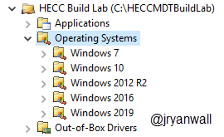
Import OS to MDT
Download Windows 10 ISO from Microsoft VLSC
Create folders for each OS

Slide 37
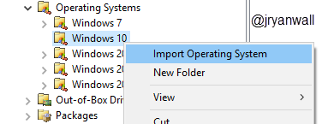
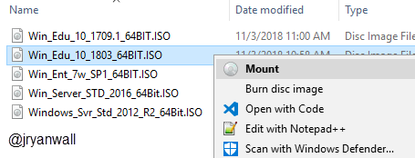
Import OS to MDT
Mount the downloaded ISO
Right click on Win 10 folder
Select Import Operating System

Slide 38
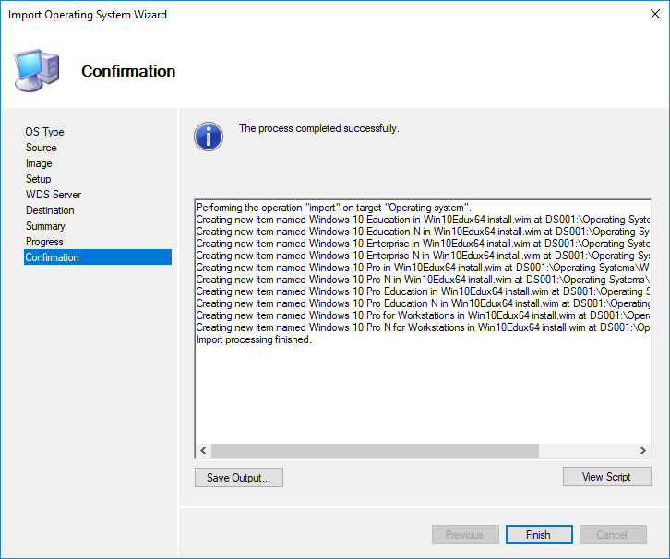
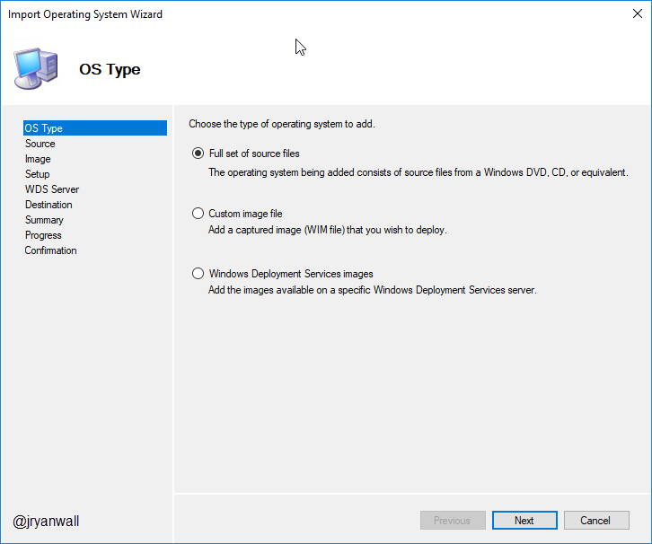
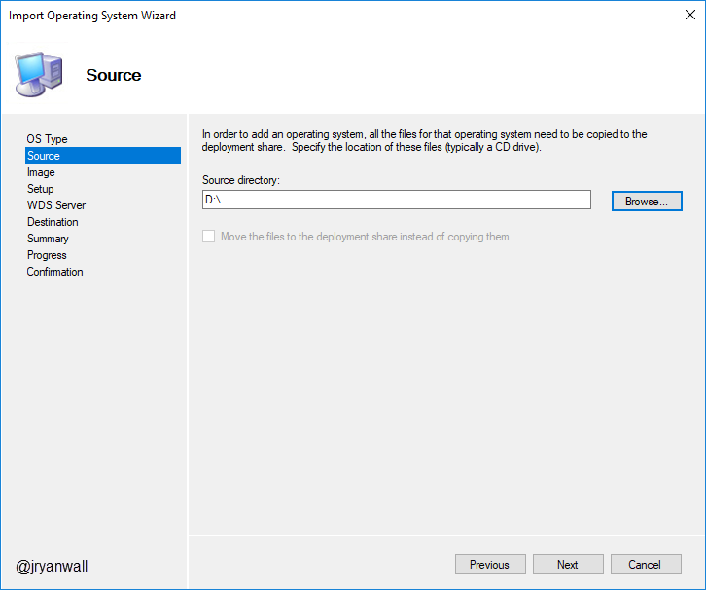
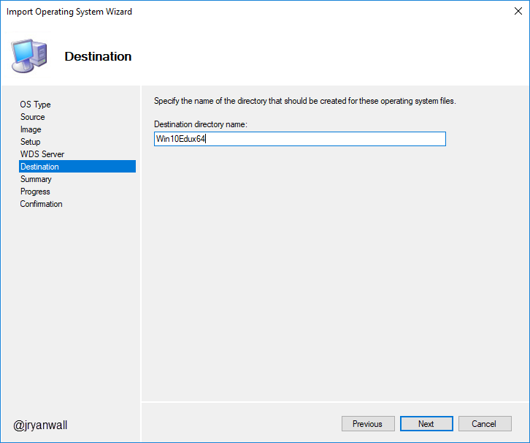
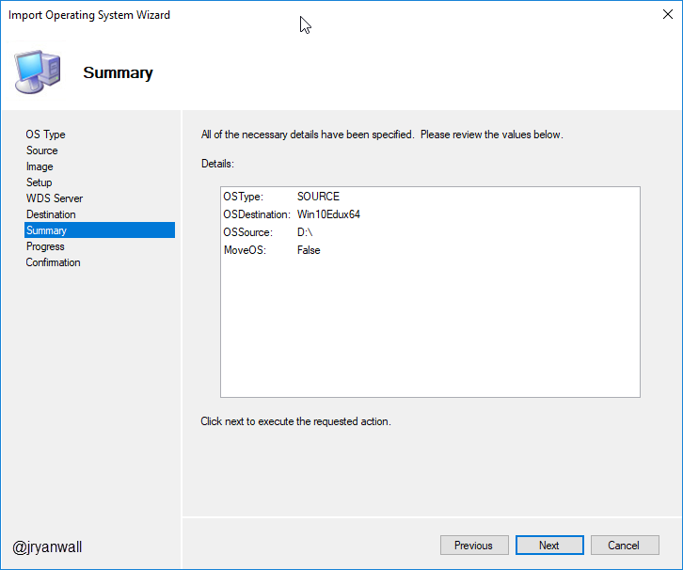
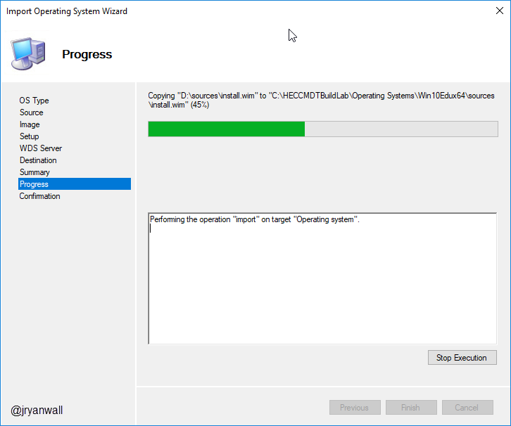
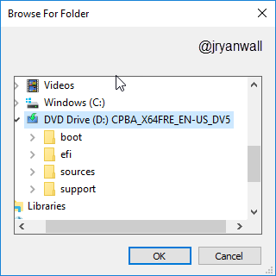
Import OS to MDT
Notes:
PowerShell Script
Import-Module "C:\Program Files\Microsoft Deployment Toolkit\bin\MicrosoftDeploymentToolkit.psd1"
New-PSDrive -Name "DS001" -PSProvider MDTProvider -Root "C:\HECCMDTBuildLab"
import-mdtoperatingsystem -path "DS001:\Operating Systems\Windows 10" -SourcePath "D:\" -DestinationFolder "Win10Edux64" -Verbose

Slide 39
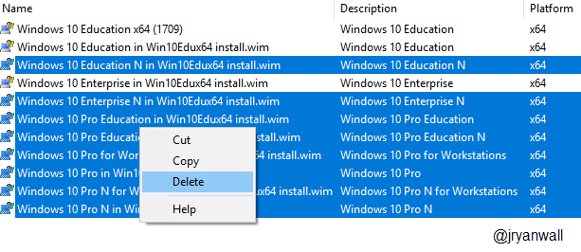
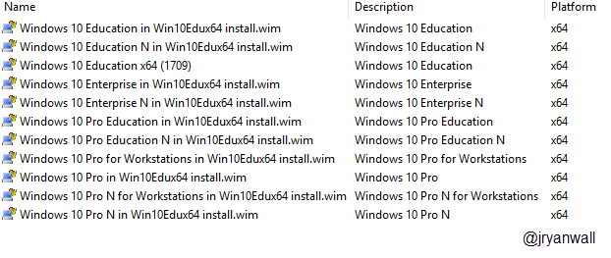
Import OS to MDT
After import you will have extra versions of the OS
Highlight what you don’t want and delete them

Slide 40
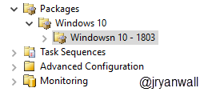
Import OS to MDT
Need to download Windows 10 v1803 updates (Optional)
https://support.microsoft.com/en-us/help/4099479
Or use PowerShell Script to find updates
Under Packages
Create a Windows 10 folder and then under that a Windows 10 – 1803 folder

Slide 41
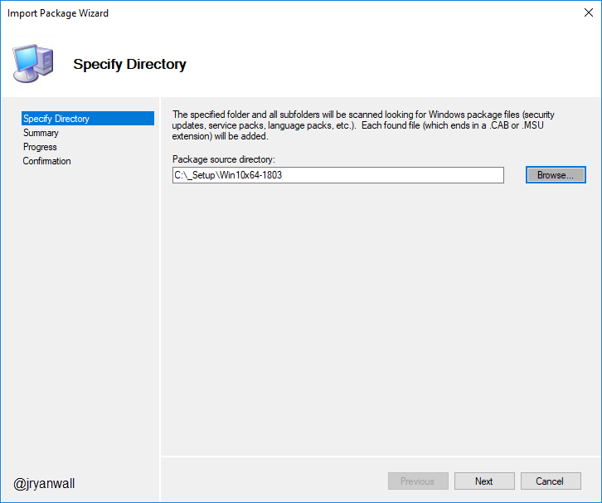
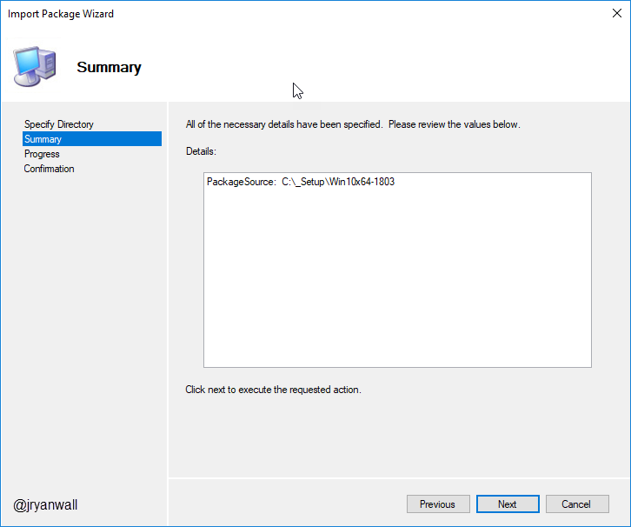
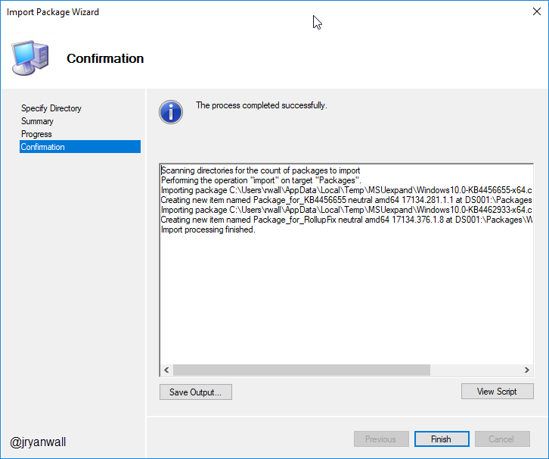
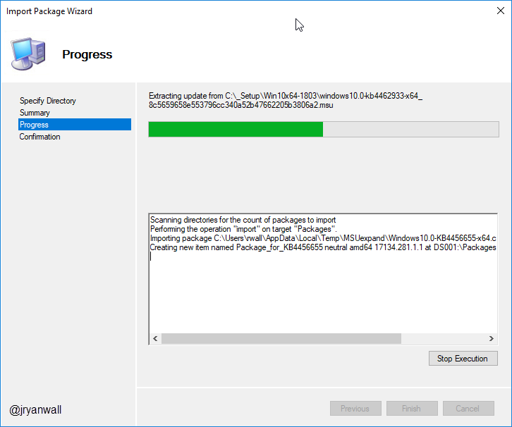
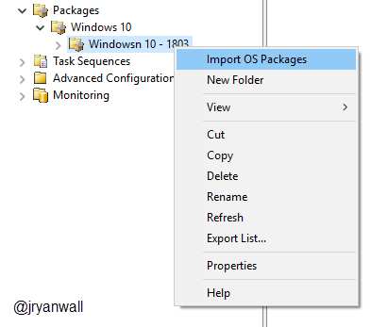
Import OS to MDT
Import OS Packages

Slide 42
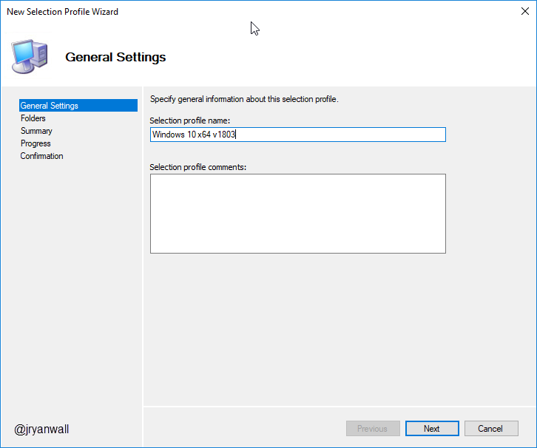
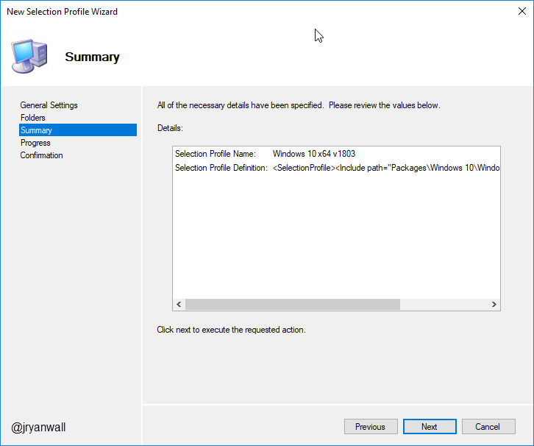
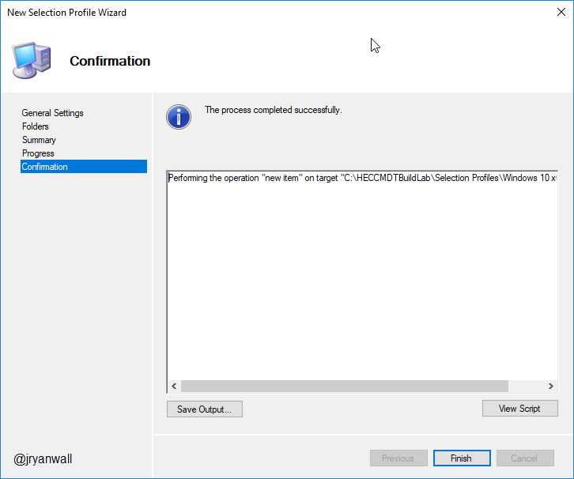
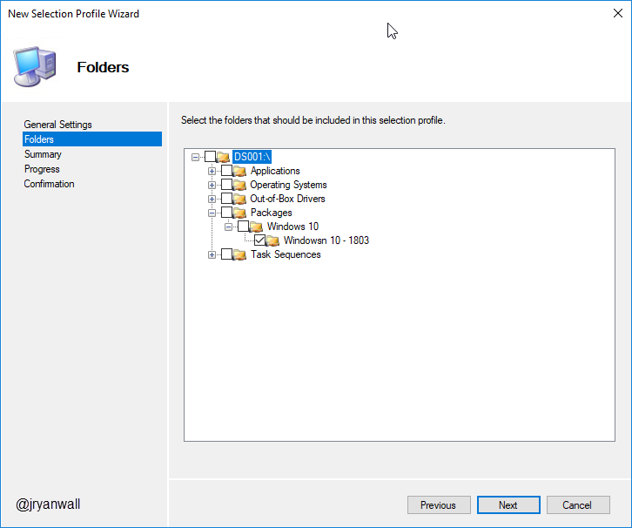
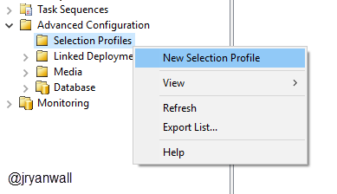
Import OS to MDT
Create Selection Profile

Slide 43
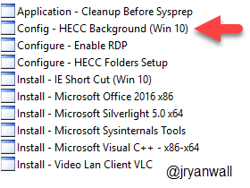
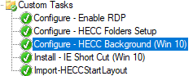
Customizing/Tweaking OS Background Tweak
Script comes from a post found here
https://garytown.com/windows-10-customizations-mms2017-demos
You basically overwrite default backgrounds
This will not survive a Feature Upgrade
I add it as an Application so that the script will run
Then just add it to Task sequence

Slide 44
Customizing/Tweaking OS Lock Screen Changes
This is part of Tweak - Windows 10 Settings
It also does other tweaks
Read the CMD to understand
This will be part of a future PowerShell script. Ran out of time
Reason to come back next year???

Slide 45
Customizing/Tweaking OS Remove Built-in Apps
Need 3 scripts to make work
2 from Deployment Research
https://deploymentresearch.com/Research/Post/615/Fixing-why-Sysprep-fails-in-Windows-10-due-to-Windows-Store-updates
And main script from SCConfigMgr.com
http://www.scconfigmgr.com/2018/05/13/remove-built-in-apps-for-windows-10-version-1803/
Copy all three scripts to %DeploymentRoot%\scripts folder

Slide 46
Task Sequence Create Task Sequence
Create Folder under Task Sequences for Windows 10
Create Windows 10 Education x64 build 1803 (Nov 2018) Task Sequence
Input a unique Task sequence ID
Input a Task sequence name
Use the Standard Client Task Sequence
Select Windows 10 Education x64 1803 OS
Add OS Settings
Do not specify an Administrator password
Notes:
PowerShell Script
Import-Module "C:\Program Files\Microsoft Deployment Toolkit\bin\MicrosoftDeploymentToolkit.psd1"
New-PSDrive -Name "DS001" -PSProvider MDTProvider -Root "C:\HECCMDTBuildLab"
import-mdttasksequence -path "DS001:\Task Sequences\Windows 10" -Name "Windows 10 Education x64 build 1803 (Nov 2018)" -Template "Client.xml" -Comments "Windows 10 Education build 1803 (November 2018)
Designed for HECC" -ID "Win10Edu1803-001" -Version "1.0" -OperatingSystemPath "DS001:\Operating Systems\Windows 10\Windows 10 Education x64 (1803)" -FullName "HECC" -OrgName "Hoosier Educational Computer Coordinators" -HomePage "https://hecc.k12.in.us/" -Verbose

Slide 47
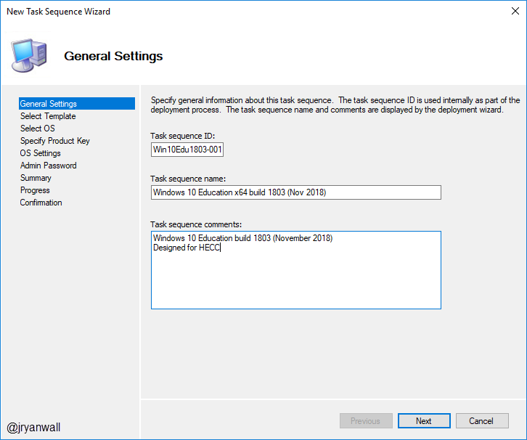
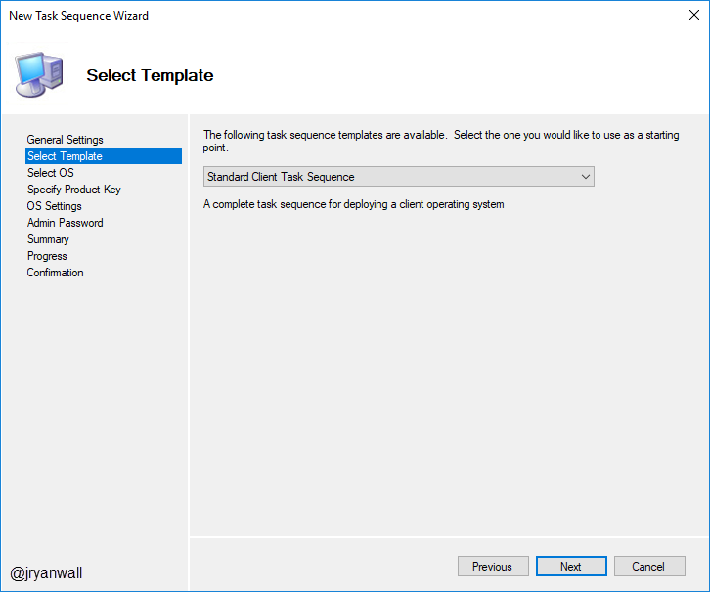
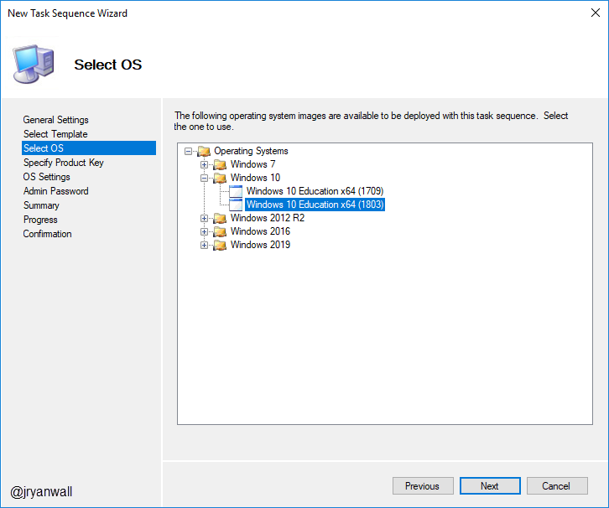
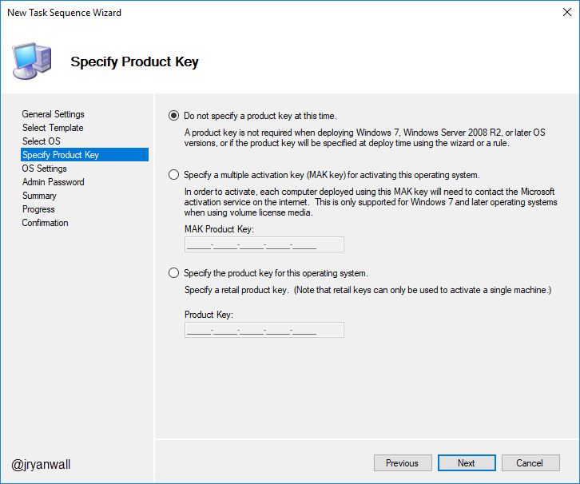
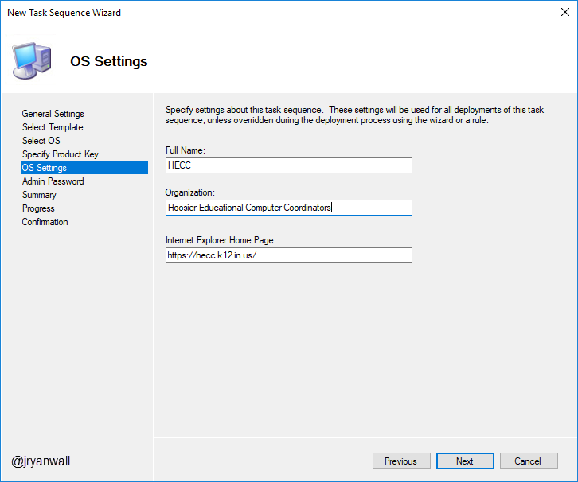
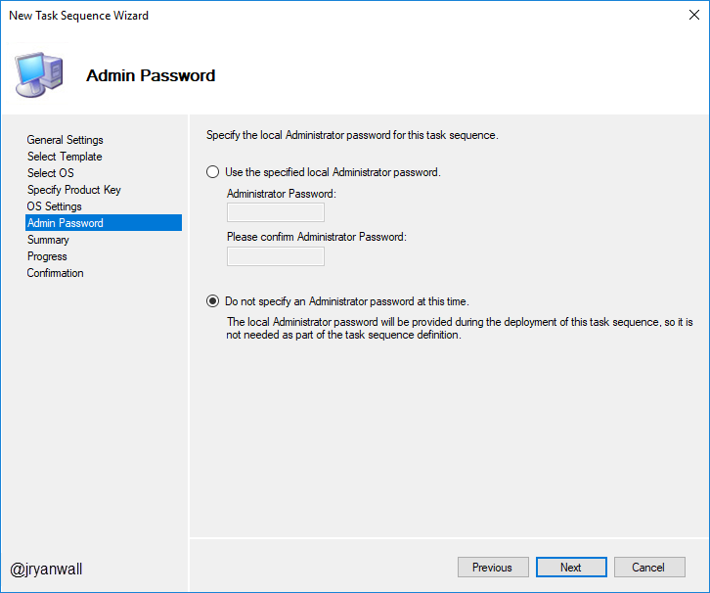
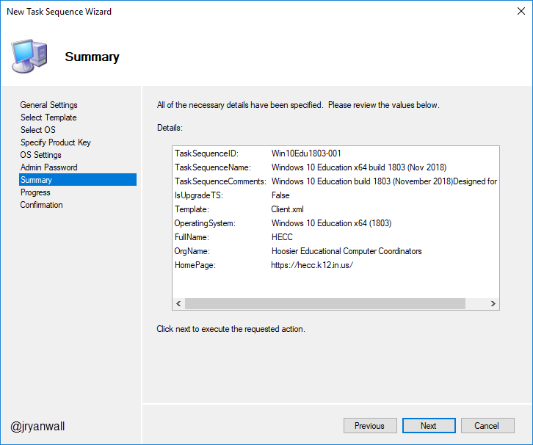
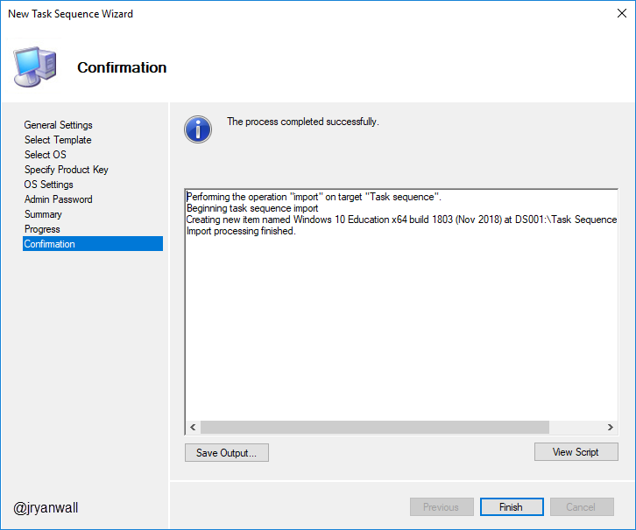
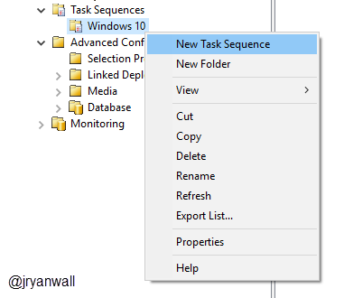
Task Sequence Create Task Sequence
Notes:
PowerShell Script
Import-Module "C:\Program Files\Microsoft Deployment Toolkit\bin\MicrosoftDeploymentToolkit.psd1"
New-PSDrive -Name "DS001" -PSProvider MDTProvider -Root "C:\HECCMDTBuildLab"
import-mdttasksequence -path "DS001:\Task Sequences\Windows 10" -Name "Windows 10 Education x64 build 1803 (Nov 2018)" -Template "Client.xml" -Comments "Windows 10 Education build 1803 (November 2018)
Designed for HECC" -ID "Win10Edu1803-001" -Version "1.0" -OperatingSystemPath "DS001:\Operating Systems\Windows 10\Windows 10 Education x64 (1803)" -FullName "HECC" -OrgName "Hoosier Educational Computer Coordinators" -HomePage "https://hecc.k12.in.us/" -Verbose

Slide 48
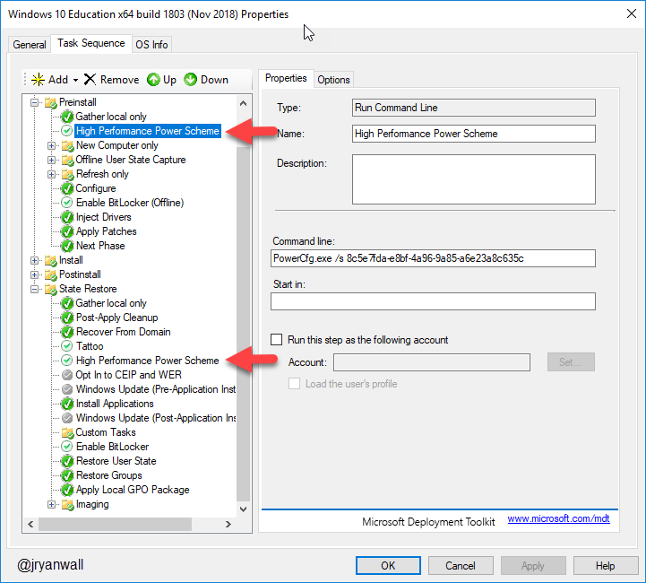
Task Sequence Adjust Power Plan
Adjust power plan to reduce deployment time
https://blogs.technet.microsoft.com/deploymentguys/2015/03/26/reducing-windows-deployment-time-using-power-management
PowerCfg.exe /s 8c5e7fda-e8bf-4a96-9a85-a6e23a8c635c

Slide 49
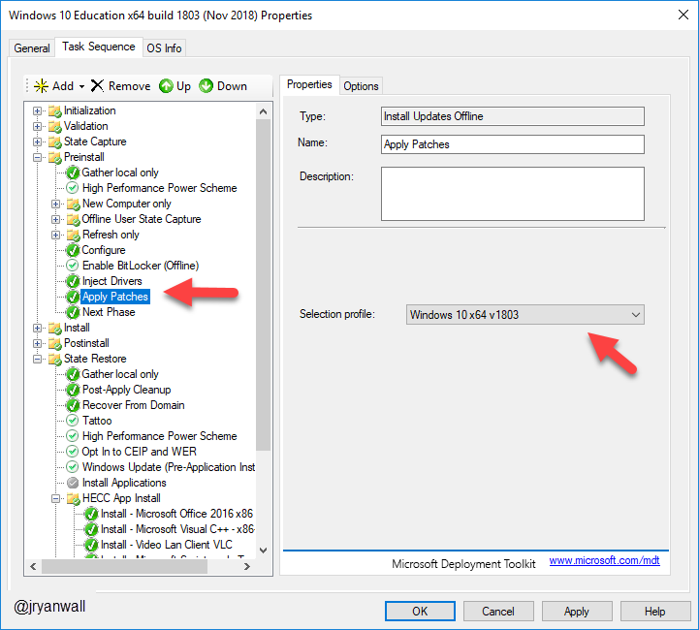
Task Sequence Apply OS Updates
Apply updates by selecting selection profile we set up earlier

Slide 50
Task Sequence Configure - Enable RDP
Add Application
Configure - Enable RDP
PowerShell Script
$rdp = Get-WmiObject -Class Win32_TerminalServiceSetting -Namespace root\CIMV2\TerminalServices -Authentication PacketPrivacy
$tmp_rdp = $rdp.SetAllowTSConnections(1,1) #first parameter rdp enable, second parameter firewall ports config
Notes:
PowerShell Script
Import-Module "C:\Program Files\Microsoft Deployment Toolkit\bin\MicrosoftDeploymentToolkit.psd1"
New-PSDrive -Name "DS001" -PSProvider MDTProvider -Root "C:\HECCMDTBuildLab"
import-MDTApplication -path "DS001:\Applications" -enable "True" -Name "Configure - Enable RDP" -ShortName "Configure - Enable RDP" -Version "" -Publisher "" -Language "EN" -CommandLine "powershell.exe -Command `"Set-ExecutionPolicy Unrestricted -Force; Copy-Item 'Z:\Applications\Configure - Enable RDP\Configure - Enable RDP.ps1' -destination c:\; c:\Configure - Enable RDP.ps1; Remove-Item c:\*.ps1 -Force; set-ExecutionPolicy Restricted -Force`"" -WorkingDirectory ".\Applications\Configure - Enable RDP" -ApplicationSourcePath "C:\_Setup\_AppInstallFiles\Configure - Enable RDP" -DestinationFolder "Configure - Enable RDP" -Verbose

Slide 51

Task Sequence Cleanup Before Sysprep
Get rid of all junk before Sysprep and Capture when creating a reference image in MDT
https://deploymentbunny.com/2014/06/05/nice-to-know-get-rid-of-all-junk-before-sysprep-and-capture-when-creating-a-reference-image-in-mdt/

Slide 52
Demo

Slide 53
Questions

Slide 54
Helpful Info
Deployment Research
Building a Windows 10 v1809 reference image using Microsoft Deployment Toolkit (MDT)
https://deploymentresearch.com/Research/Post/1676/Building-a-Windows-10-v1809-reference-image-using-Microsoft-Deployment-Toolkit-MDT
Building a Windows 10 v1709 reference image using MDT
https://deploymentresearch.com/Research/Post/654/Building-a-Windows-10-v1709-reference-image-using-MDT
Building the perfect Windows Server 2016 reference image
https://deploymentresearch.com/Research/Post/578/Building-the-perfect-Windows-Server-2016-reference-image
Back to Basics - Building a Windows 7 SP1 Reference Image using MDT 2013 Update 2
https://deploymentresearch.com/Research/Post/521/Back-to-Basics-Building-a-Windows-7-SP1-Reference-Image-using-MDT-2013-Update-2

Slide 55
Section 3
Getting things started on the right foot.

Slide 56
Agenda – Section 3
Build, Capture, Automation
Build and Capture
Image Factory
Demo
Questions

Slide 57





Build and Capture
Configure WinPE settings

Slide 58

Build and Capture
After all changes are made update deployment share

Slide 59
Build and Capture
Create a new Hyper-V on build machine
2 Processors makes a big difference
Only need 4 GB of ram
Mount HECC Build Lab x64.iso from %DeploymentShare%\Boot\
Power on VM
Select you Task Sequence

Slide 60
Image Factory
This is a way to Automate building all of your images
Can be found here
https://github.com/DeploymentBunny/IMF4

Slide 61
Demo

Slide 62
Questions

Slide 63
Section 4
Getting things started on the right foot.

Slide 64
Agenda – Section 4
Setup
Create Deployment Share
Customize Deployment Share
Import Custom WIM
WDS and PXE setup
Create Task Sequence
Demo
Questions

Slide 65

Deployment Share
Create Deployment Share – HECC Deployment
Open Deployment Workbench
Right Click on Deployment Share and select New Deployment Share
Deployment Share name HECCDeploy$
Deployment Share Description HECC Deployment Share
Notes:
PowerShell
New-SmbShare -Name "HECCDeploy$" -Path "E:\HECCDeploy" -FullAccess Administrators
Import-Module "C:\Program Files\Microsoft Deployment Toolkit\bin\MicrosoftDeploymentToolkit.psd1"
new-PSDrive -Name "DS002" -PSProvider "MDTProvider" -Root "E:\HECCDeploy" -Description "HECC Deployment Share" -NetworkPath "\\MDT01\HECCDeploy$" -Verbose | add-MDTPersistentDrive -Verbose

Slide 66
Deployment Share settings
Again focusing on Bootstrap.ini and CustomSettings.ini
Bootstrap.ini
For Demo I have share username and password in file. You need to make the call in your environment. Others will have access to this image
Different settings for Deployment. Some the same.
We will highlight some special cases later.
I put a copy of both files in class files.
Notes:
Bootstap.ini
https://itinlegal.wordpress.com/2017/10/17/mdt-tutorial-part-5/
CustomSettings.ini
https://itinlegal.wordpress.com/2017/10/15/mdt-tutorial-part-4/
https://deploymentbunny.com/2012/04/21/back-to-basic-customsettings-ini-explained/
https://deploymentbunny.com/2015/05/22/back-to-basic-customsettings-ini-converting-desktop-and-laptop-computer-types-into-roles/

Slide 67







Importing WIM
You should have Golden Image WIM file created with process from last class
Also have Windows 10 1803 ISO mounted
Make folders for Each OS in Operating Systems fold in Workbench
Notes:
PowerShell Script
Import-Module "C:\Program Files\Microsoft Deployment Toolkit\bin\MicrosoftDeploymentToolkit.psd1"
New-PSDrive -Name "DS002" -PSProvider MDTProvider -Root "E:\HECCDeploy"
import-mdtoperatingsystem -path "DS002:\Operating Systems\Windows 10" -SourceFile "E:\MDTBuildLab\Captures\REFWIN10EDU1803_10-23-2018.wim" -DestinationFolder "Win101803v001" -SetupPath "F:\" -Verbose

Slide 68

Importing WIM

Slide 69
WDS and PXE
WDS and PXE are used to Deploy the image
You need the Windows Deployment Services installed on your MDT Server
Only change I make to default install is on TFTP tab of WDS.
I increase Maximum Block Size to 16384
You will also import HECC_Deployment_x64.wim to be PXE image

Slide 70








Create Task Sequence
Create folder for major OS’s
Win 10
Win 7
Win 2016

Slide 71
Demo

Slide 72
Section 5
Getting things started on the right foot.

Slide 73
Agenda – Section 5
Drivers and BIOS
Modern Driver Implementation
Model Alias
Driver Automation Tool
BIOS upgrade during deployment
Task Sequence adjustments for drivers and BIOS update
Demo
Questions

Slide 74

Modern Driver Implementation
Only install Drivers for the Machine and OS you are deploying to
Organized Drivers to make updating them less of a pain
Does require Model Alias Script

Slide 75
Model Alias
VB Script (AliasUserExit.vbs) to help with Modern Driver Implementation and other functions
Sits in %DeploymentRoot%\Scripts folder
Basically creates MDT custom variables about the deployment target machine
Written Originally by Mikael Nystrom
https://deploymentbunny.com/2012/05/01/modelalias-user-exit-for-microsoft-deployment-toolkit-20102012/

Slide 76
Driver Task Sequence Adjustment
Need to create 2 Set Task Sequence Variable Tasks under Preinstall before the Inject Drivers TS
Task 1
Name - DriverGroup001
Task Sequence Variable - DriverGroup001
Value - Windows 10 x64\%MakeAlias%\%ModelAlias%
Task 2
Name - DriverGroup002
Task Sequence Variable - DriverGroup002
Value - Windows 10 x64\Generic
Set Inject Drivers to Nothing

Slide 77



Driver Task Sequence Adjustment

Slide 78
Driver Automation Tool
Built by Maurice Daly - @modaly_it
Can be found at
http://www.scconfigmgr.com/2018/08/28/driver-automation-tool-6-1-0-released/
GUI Based
Works with MDT and SCCM
Works with
Dell
HP
Lenovo
Microsoft

Slide 79
BIOS upgrade during deployment
PowerShell script to install BIOS updates for HP and Dell machines
Idea taken from this post by Mikael Nystrom
https://deploymentbunny.com/2016/07/20/osd-bios-upgrade-during-os-deployment-in-mdtconfigmgr-v3/
I have tweaked it to make it work for me
Also depend on Model Alias

Slide 80
BIOS upgrade Task Sequence
Add the Application Install - BIOS Upgrade
In the State Restore Section
Create new Group called BISO Upgrade
Add TS to run Application Install – BIOS Upgrade
Add Restart Computer TS
Add TS variable check NeedReboot equals YES

Slide 81
Demo

Slide 82
Section 6
Getting things started on the right foot.

Slide 83
Agenda – Section 6
Bringing it all home
Old Computer Name
Final Task Sequence Adjustment
Local Admin changes
Local accounts
Activate Office
OEM Customization
Generate Windows Experience
Bringing it all home…
Logging
Website status page
Demo
Questions

Slide 84
Old PC Name
Made possible by UserExit.vbs script in %DeploymentRoot\Scripts folder
Must have setting in Control.ini to support
OSDComputername=#GetOfflineComputername()#
Pulls old computer name during imaging process
If there was no name, throws a non-fatal error

Slide 85
Final Adjustments Local Admin Changes
Create admin account on all PC’s using following commands
cmd.exe /c net user /add Admin Local!! && cmd.exe /c net localgroup administrators Admin /add
cmd.exe /c wmic useraccount where "Name='Admin'" SET PasswordChangeable=False

Slide 86

Final Adjustments Local Admin Changes

Slide 87

Final Adjustments Local accounts
Disable Administrator Account
cmd.exe /c net user administrator /active:no

Slide 88
Final Adjustments Activate Office 2016

Slide 89
Final Adjustments OEM Information

Slide 90
Final Adjustments Generate Windows Experience
Based of off following blog post
https://deploymentresearch.com/Research/Post/624/Why-adding-WinSAT-formal-to-your-task-sequence-can-be-a-shiny-thing-to-do
Help Windows know if SSD is installed on machine
I just created a batch file with command in it
winsat formal
Put batch file as an Application in MDT

Slide 91
Logging
When things go wrong check the logs
Logs controlled by Control.ini
; Copy Logs if an error occurs or when deployment is successfully completed
SLShare=\\MDT01\HECCDeploy$\Logs
; Enable Dynamic Logging
SLSHAREDynamicLogging=\\MDT01\HECCDeploy$\DynLog\%OSDComputername%
Create both the Logs and DynLog folders in %DeploymentRoot%

Slide 92

Website status page
PowerShell Script to query MDT Monitor and show status
Output file goes to IIS server running on MDT box
Simple page but helpful when running around school imaging PC’s

Slide 93
Demo

Slide 94
Questions

Slide 95
Class files and slide deck
All the files used for class and slide deck can be found on my GitHub account.
https://github.com/jryanwall/HECC-2018
If you don’t find something or have questions shoot me an email or hit me up on Twitter
rwall@hccsc.k12.in.us
@JRyanWall
I also have a list on Twitter of related to OSD
https://twitter.com/jryanwall/lists/deployment

